Slide 1
Roundtable Presentation: Final Project
Nathan Shek

Slide 2
Idea 1:
#StopAsianHate – a short comic
[TRIGGER WARNING – VIOLENCE + IMAGES]

Slide 3
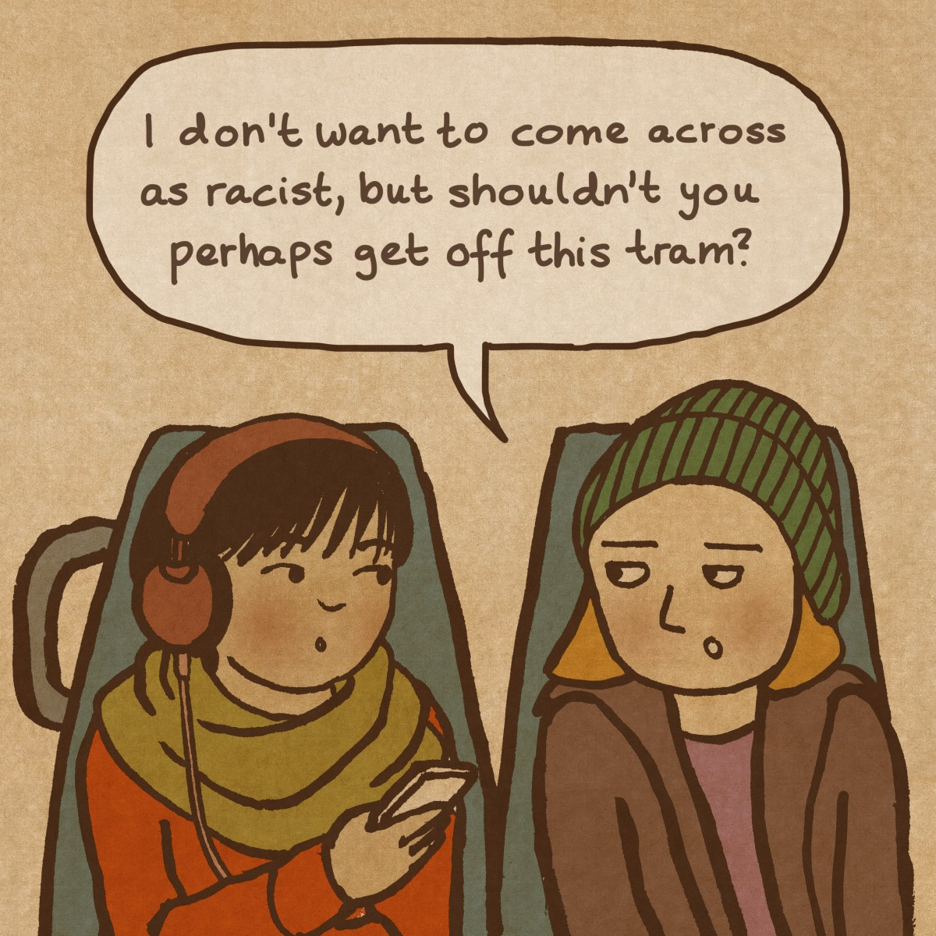
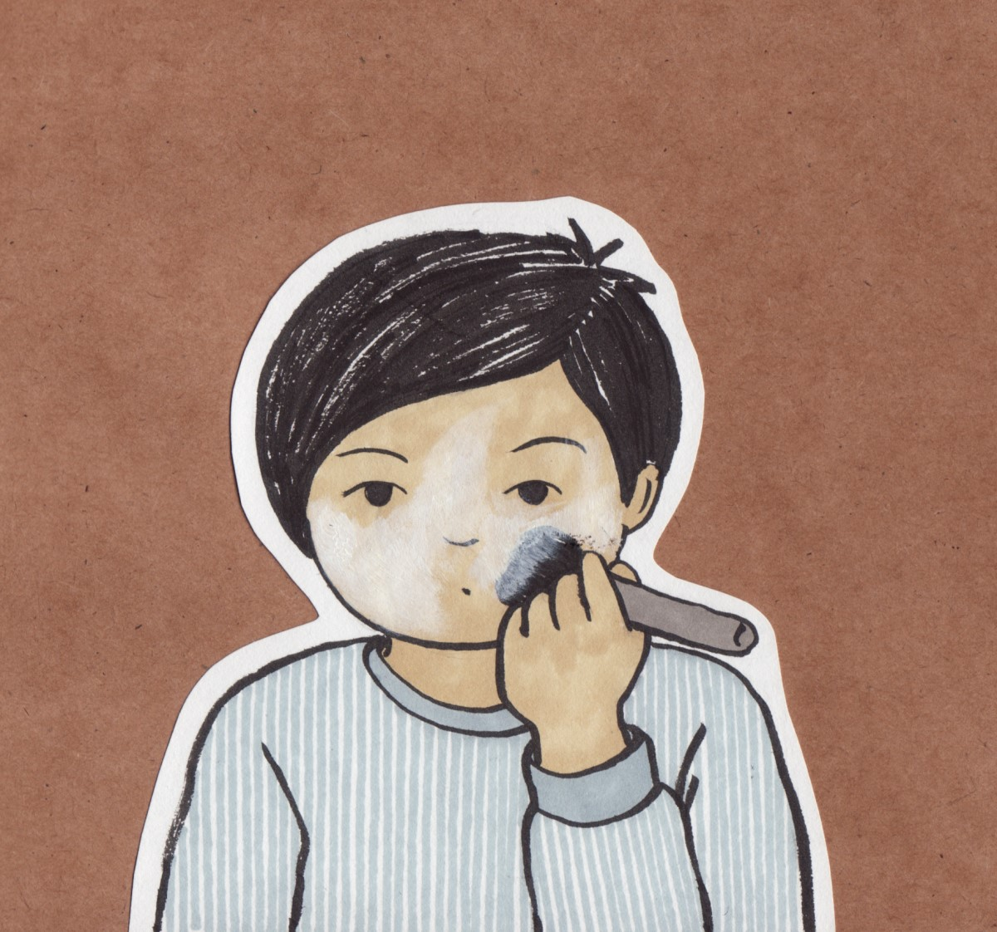
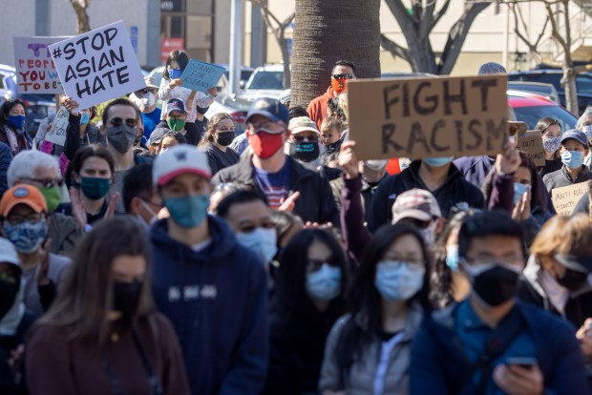
References [Idea 1]:
Cartoon panels by Lisa Wool-Rim Sjöblom
(Possible art style reference)
Heavily influenced by the recent protests
and my own personal feelings about recent events

Slide 4
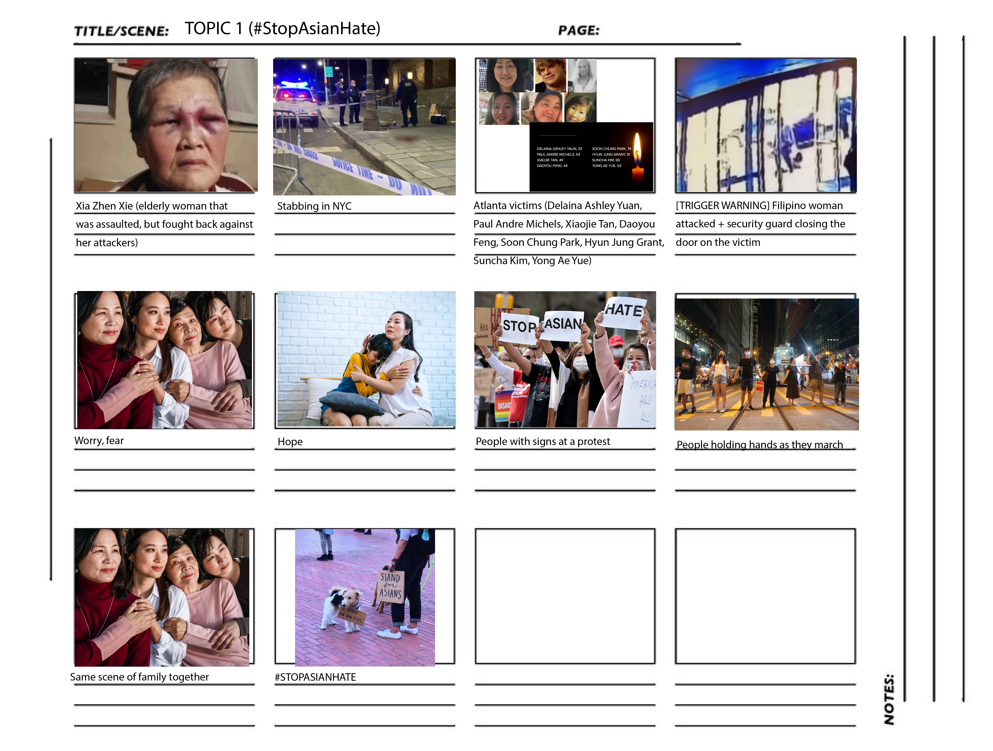
Storyboard [Idea 1] – Clickthrough animated slides or images

Slide 5
Idea 2:
Interactive Narrative: Horror

Slide 6
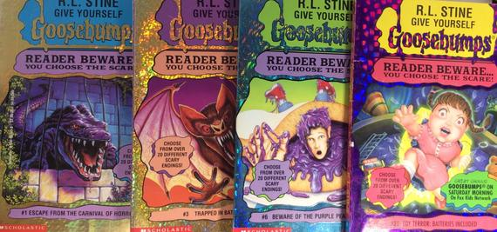
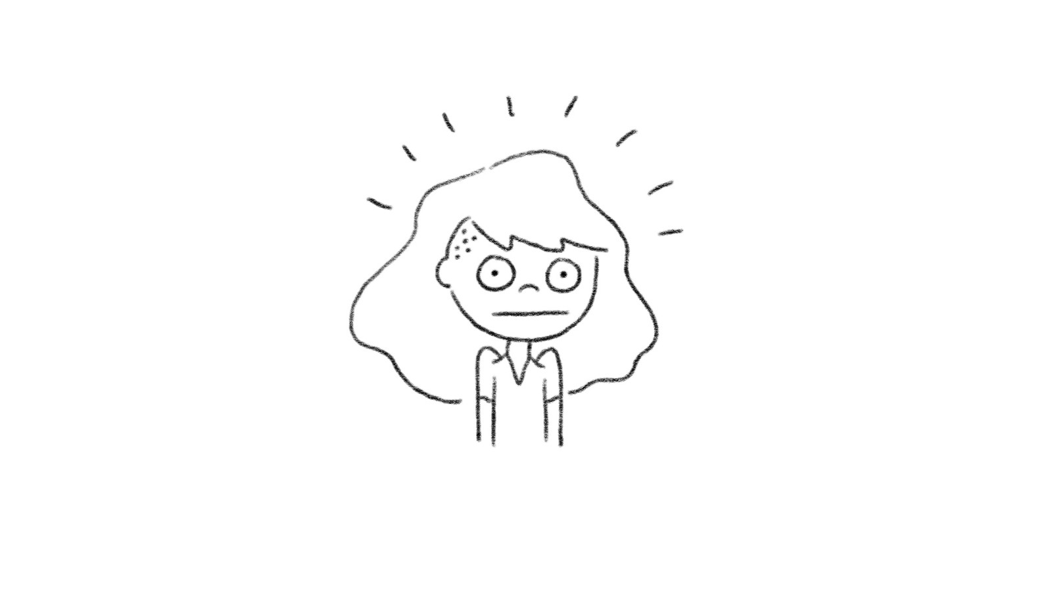
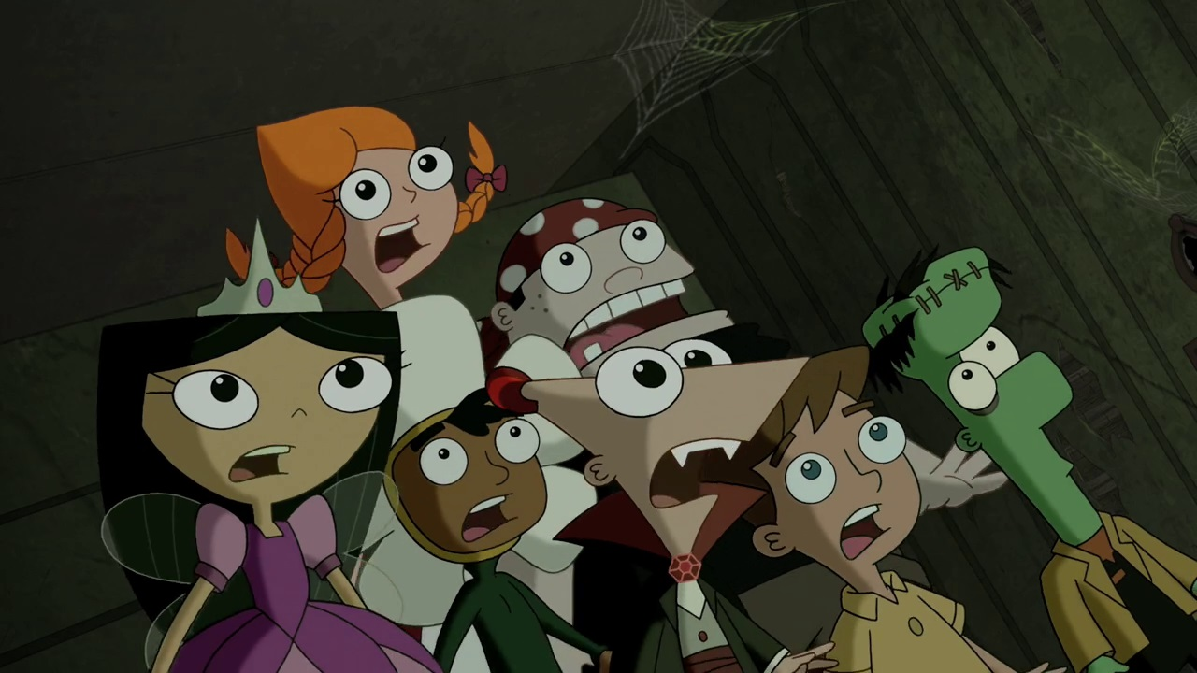
References [Idea 2]:
Goosebumps Choose-Your-Own-Adventure
Art style reference
General atmospheric reference
(Phineas and Ferb)

Slide 7
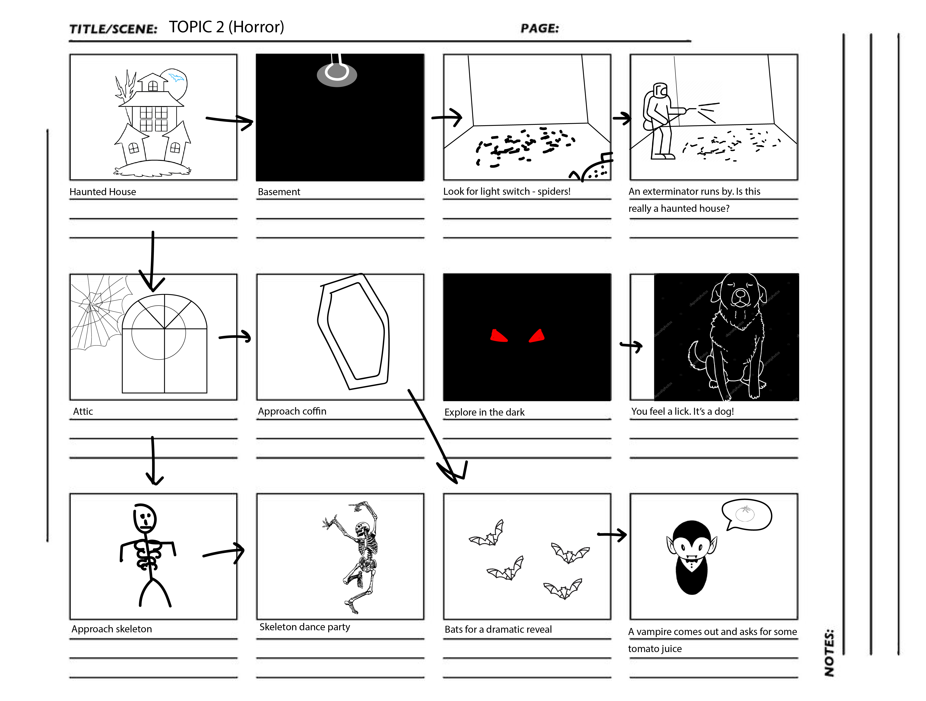
Storyboard [Idea 2] – Select options + animated drawings

Slide 8
Idea 3:
Short Animated Music Video – Love Story

Slide 9

References [Idea 3]:
Taylor Swift’s Love Story (see video)

Slide 10
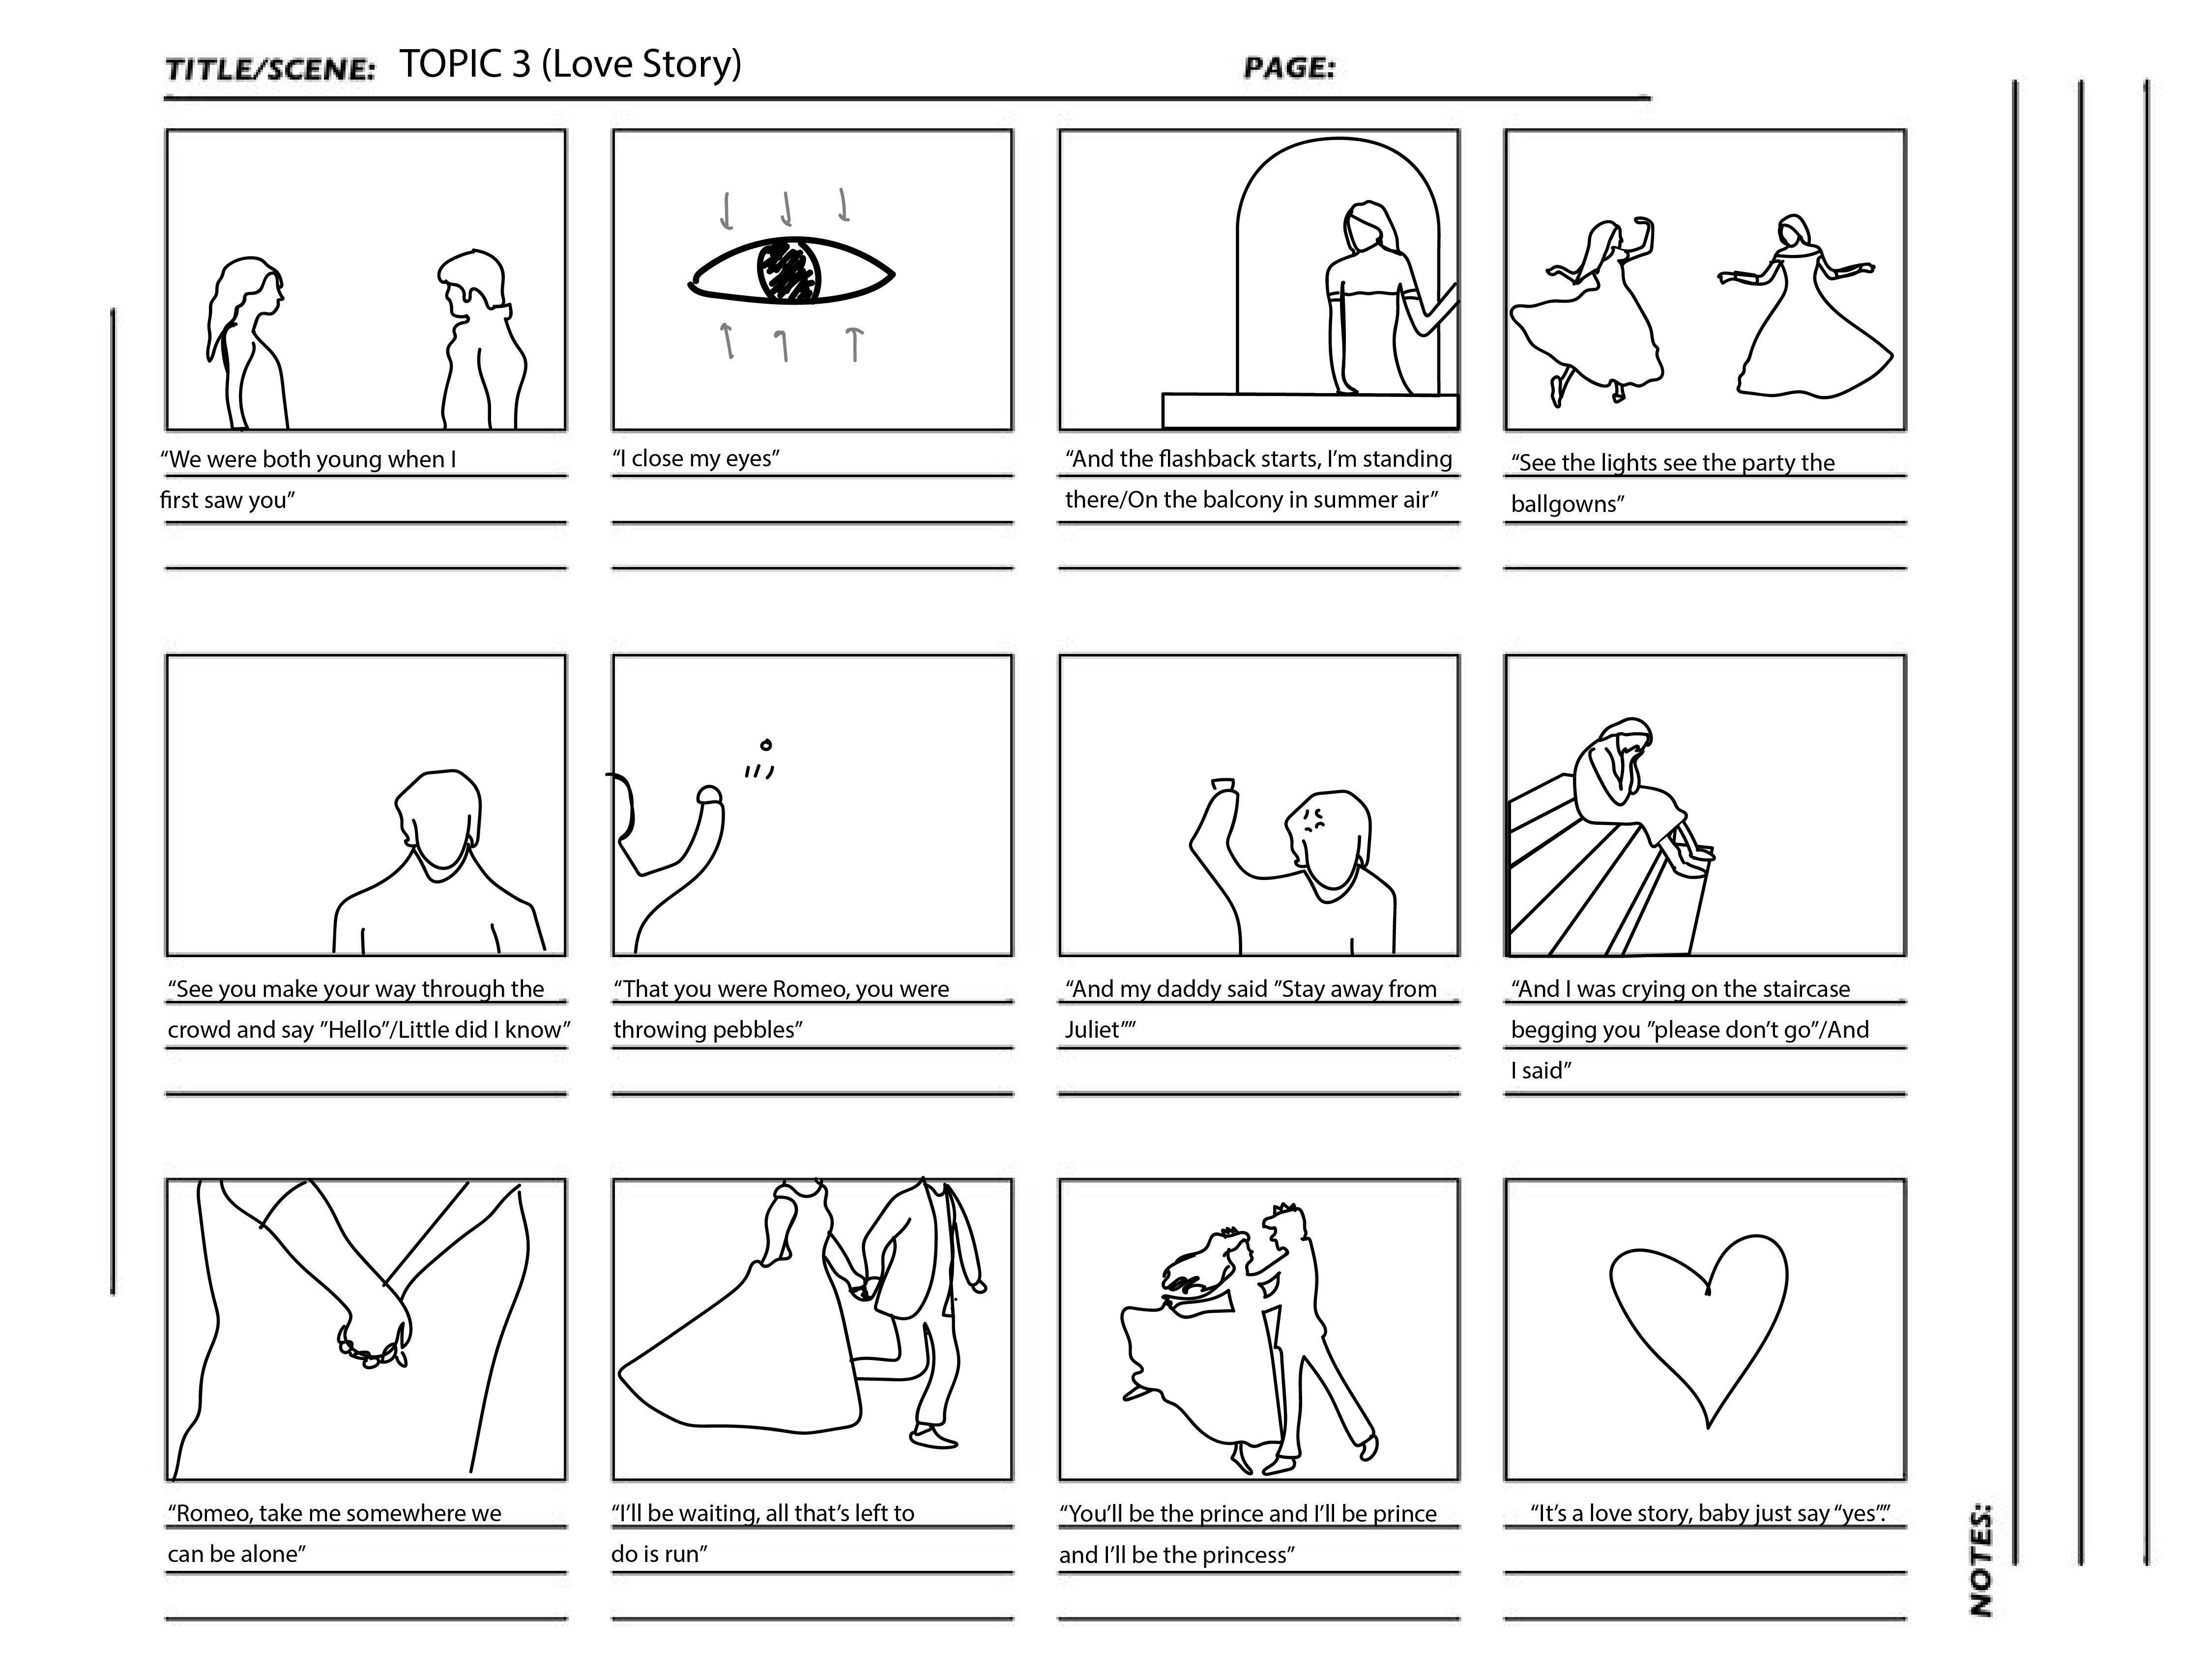
Storyboard [Idea 3] – no user interaction, animated drawings timed with the song

